Slide 1
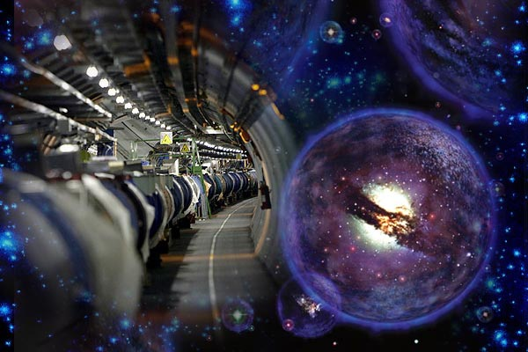
A BRIEF INTRODUCTION TO COLLIDER PHYSICS
Andrés Flórez
UNIANDES
Nov 20th, 2018

Slide 2
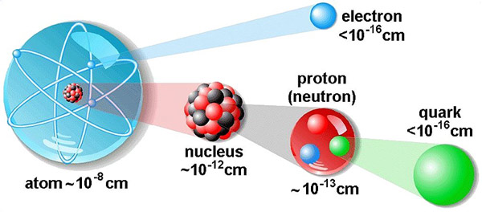
In 2400 years of history, since Democritus
We have learned that …
Everything is made out of atoms, that have an internal structure, which we describe through Quantum Mechanics. These atoms are composed of sub-atomic particles….
electron
proton
(neutron)
nucleus
Atom
Electrons and quarks are fundamental particles: Do not have known
internal structure!

Slide 3

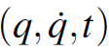
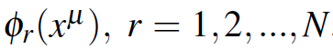
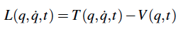
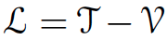
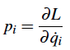
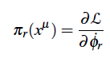
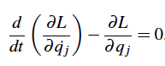
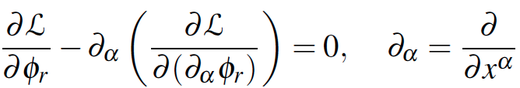
Classical mechanics vs quantum field theory
Classical Mechanics
Quantum Field Theory

Slide 4
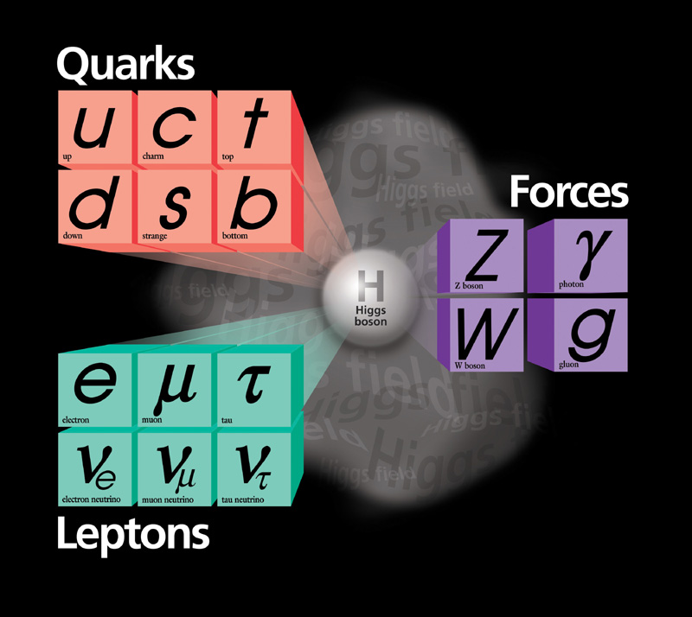
Generation
1st 2st 3st
Basic constituents of baryonic matter
F E R M I O N S
Quarks
The only difference among
Generations is the mass of the particles, being the first generation the lighest and the third the heaviest.
Leptons
So far there are only three generation of particles
Leptones

Slide 5
Fundamental Interactions
Electromagnetic Interaction
Mediated by Photons
The nuclear weak interaction is
mediated by the W± y Z⁰ bosons.
This interaction is responsible for the radioactive decays.
Forces
B O S O N S
Particles that mediate the known fundamental interactions in the SM
The nuclear strong interaction is mediated by GLUONS. This interaction is responsible for binding quarks to form protons and neutrons.

Slide 6
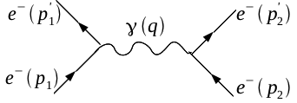
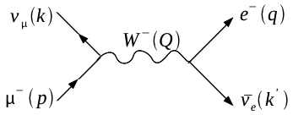
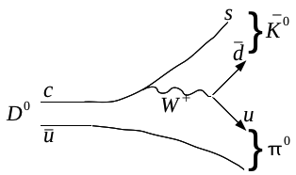
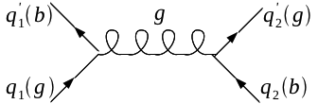
Feynman diagrams
Interacción Electromagnética
Interacción Debíl (color)
Interacción Fuerte (color)

Slide 7
Elementary particles
Baryonic matter constituents
Fuerzas
F E R M I O N S
B O S O N S
Particles that mediate interactions
Leptons

Slide 8
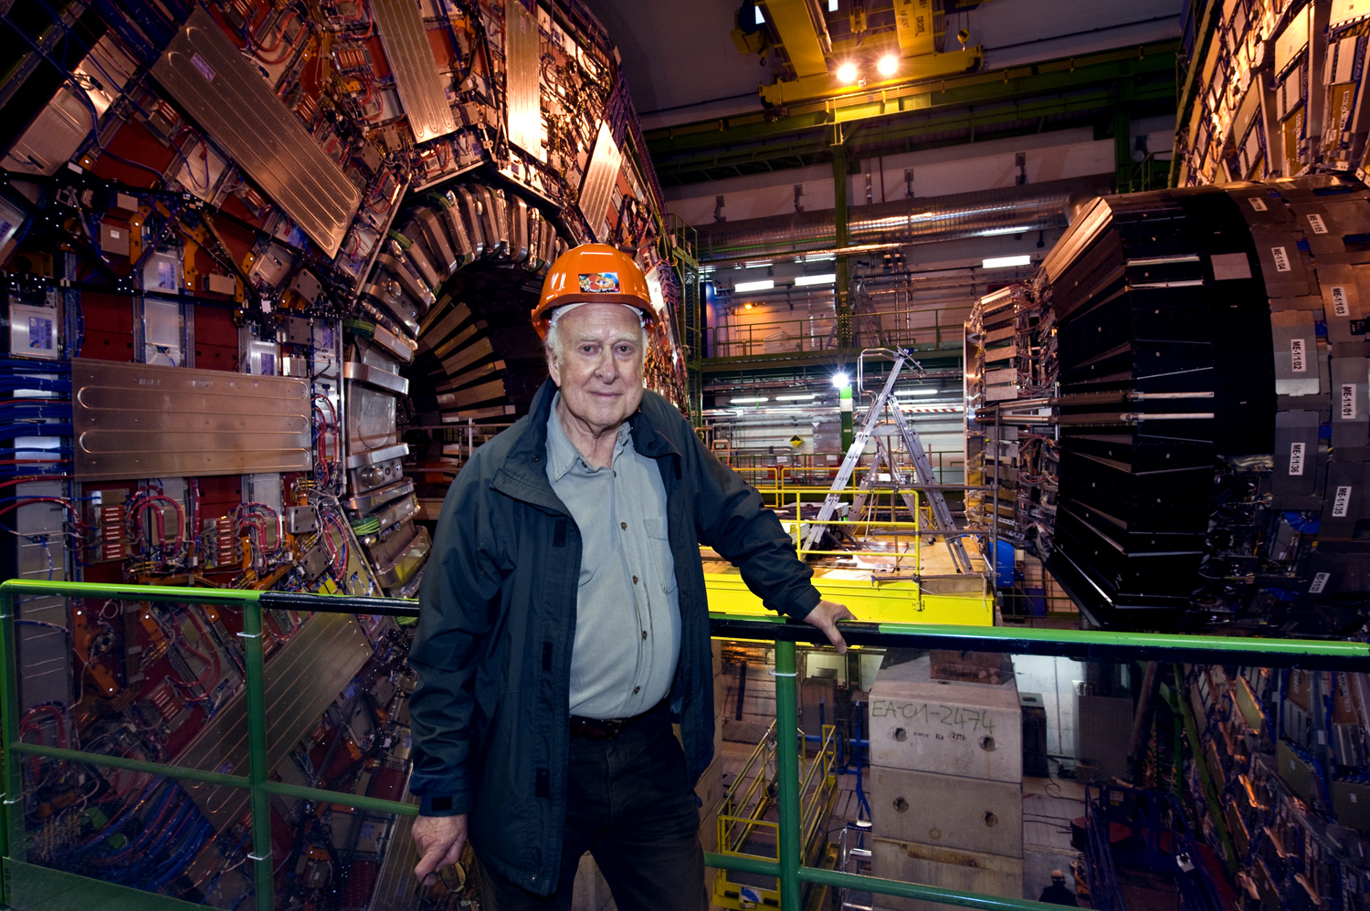
¿How do particles acquire mass?
Peter Higgs

Slide 9
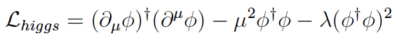
Higgs Field
Particles acquire mass through their interaction with he Higgs field
The Lagrangian for the Higgs field is given by the expression below
Minimo

Slide 10
Quarks
Higgs Field

Slide 11
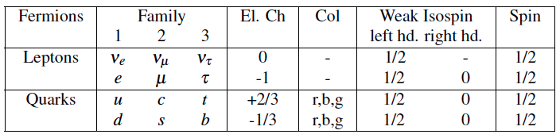
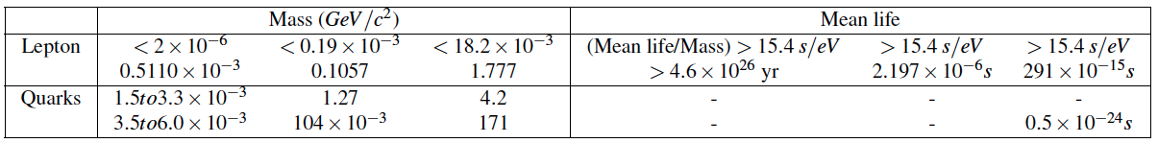
THE Standard Model

Slide 12
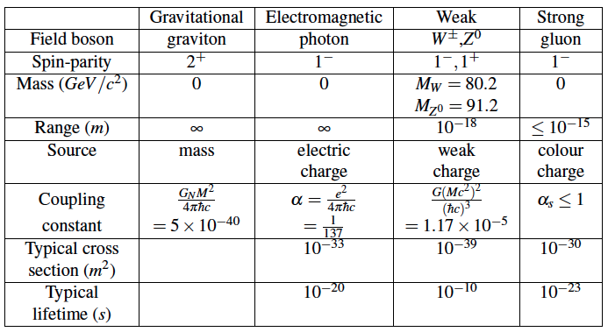
THE Standard Model

Slide 13
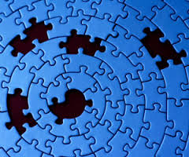
The SM, successful, but incomplete!
Does Dark Matter Exist?
What is Dark Energy?
How can we incorporate gravity?

Slide 14
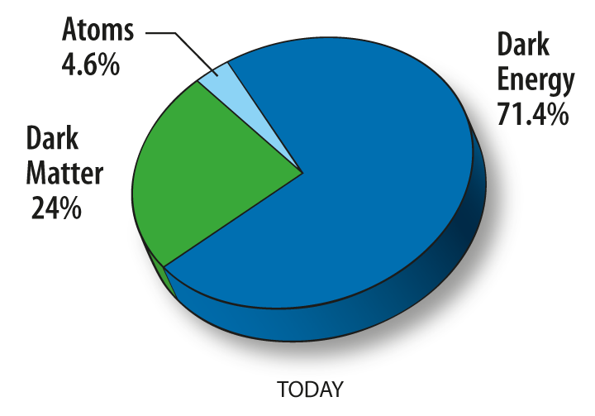

Slide 15
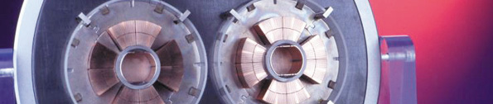
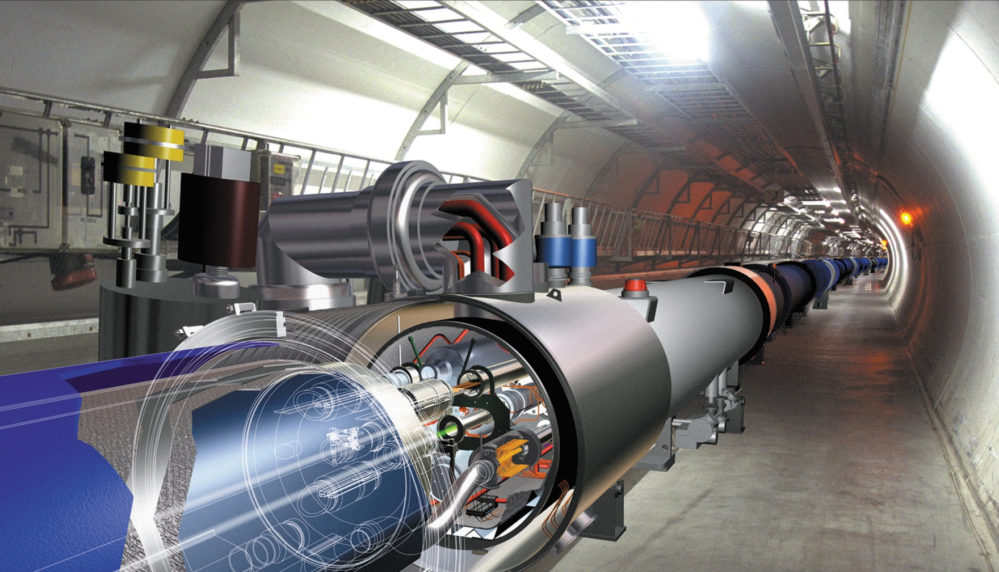
6.5 TeV
Protons
Protons
6.5 TeV
CERN - LHC Large Hadron Collider

Slide 16
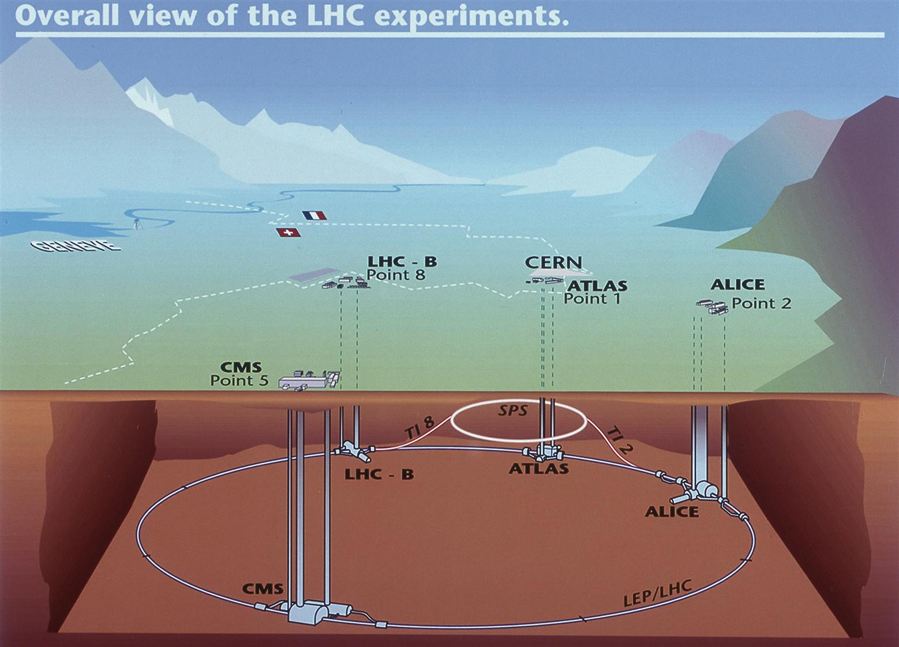
The LHC
27 km of perimeter, 100 – 150 m underground

Slide 17
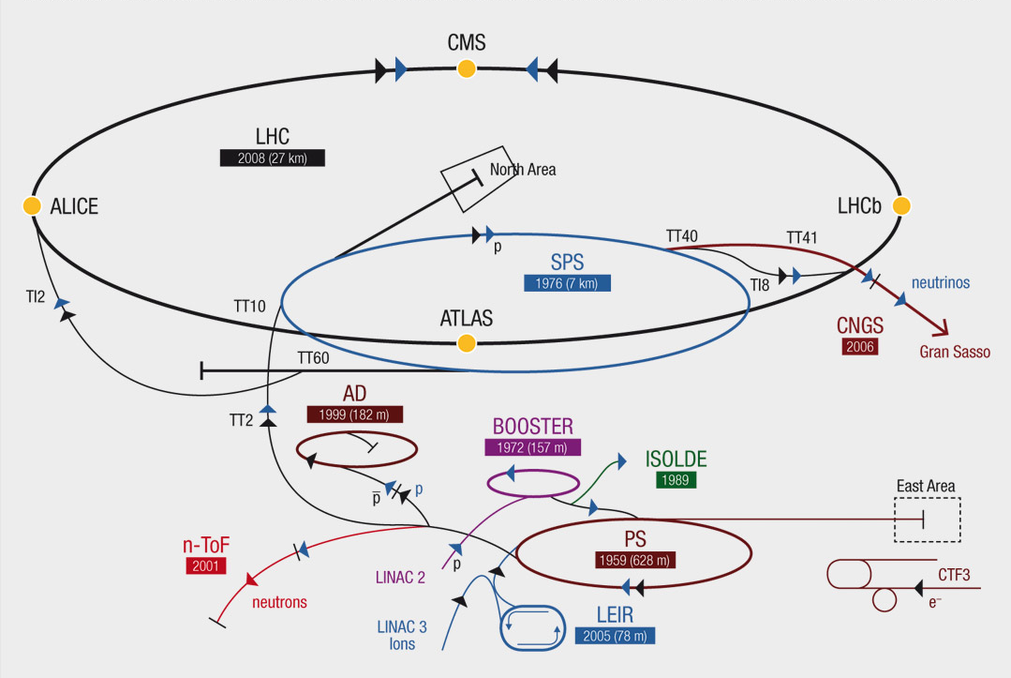
From the Linacs to the LHC

Slide 18
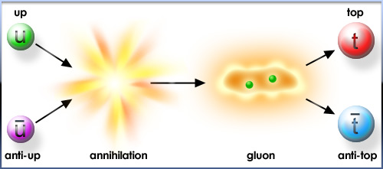
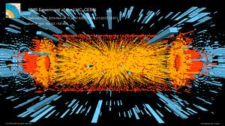
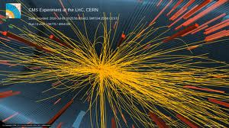

Slide 19
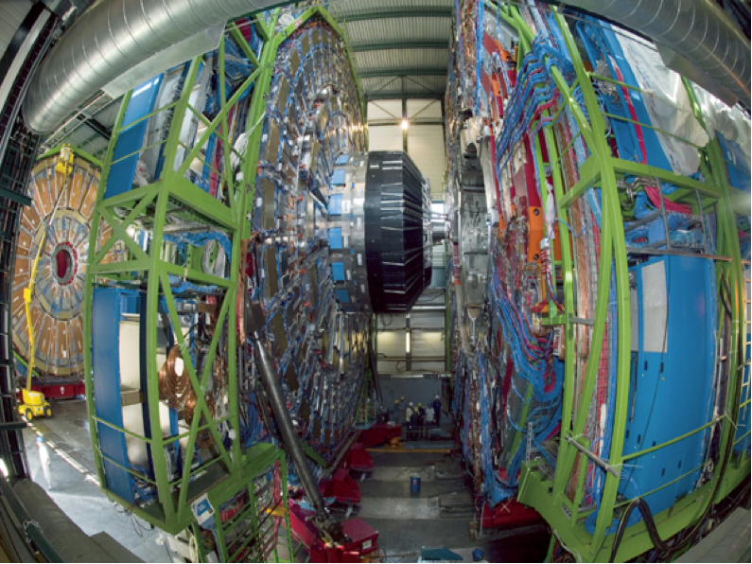
CMS
Compact Muon Solenoid

Slide 20
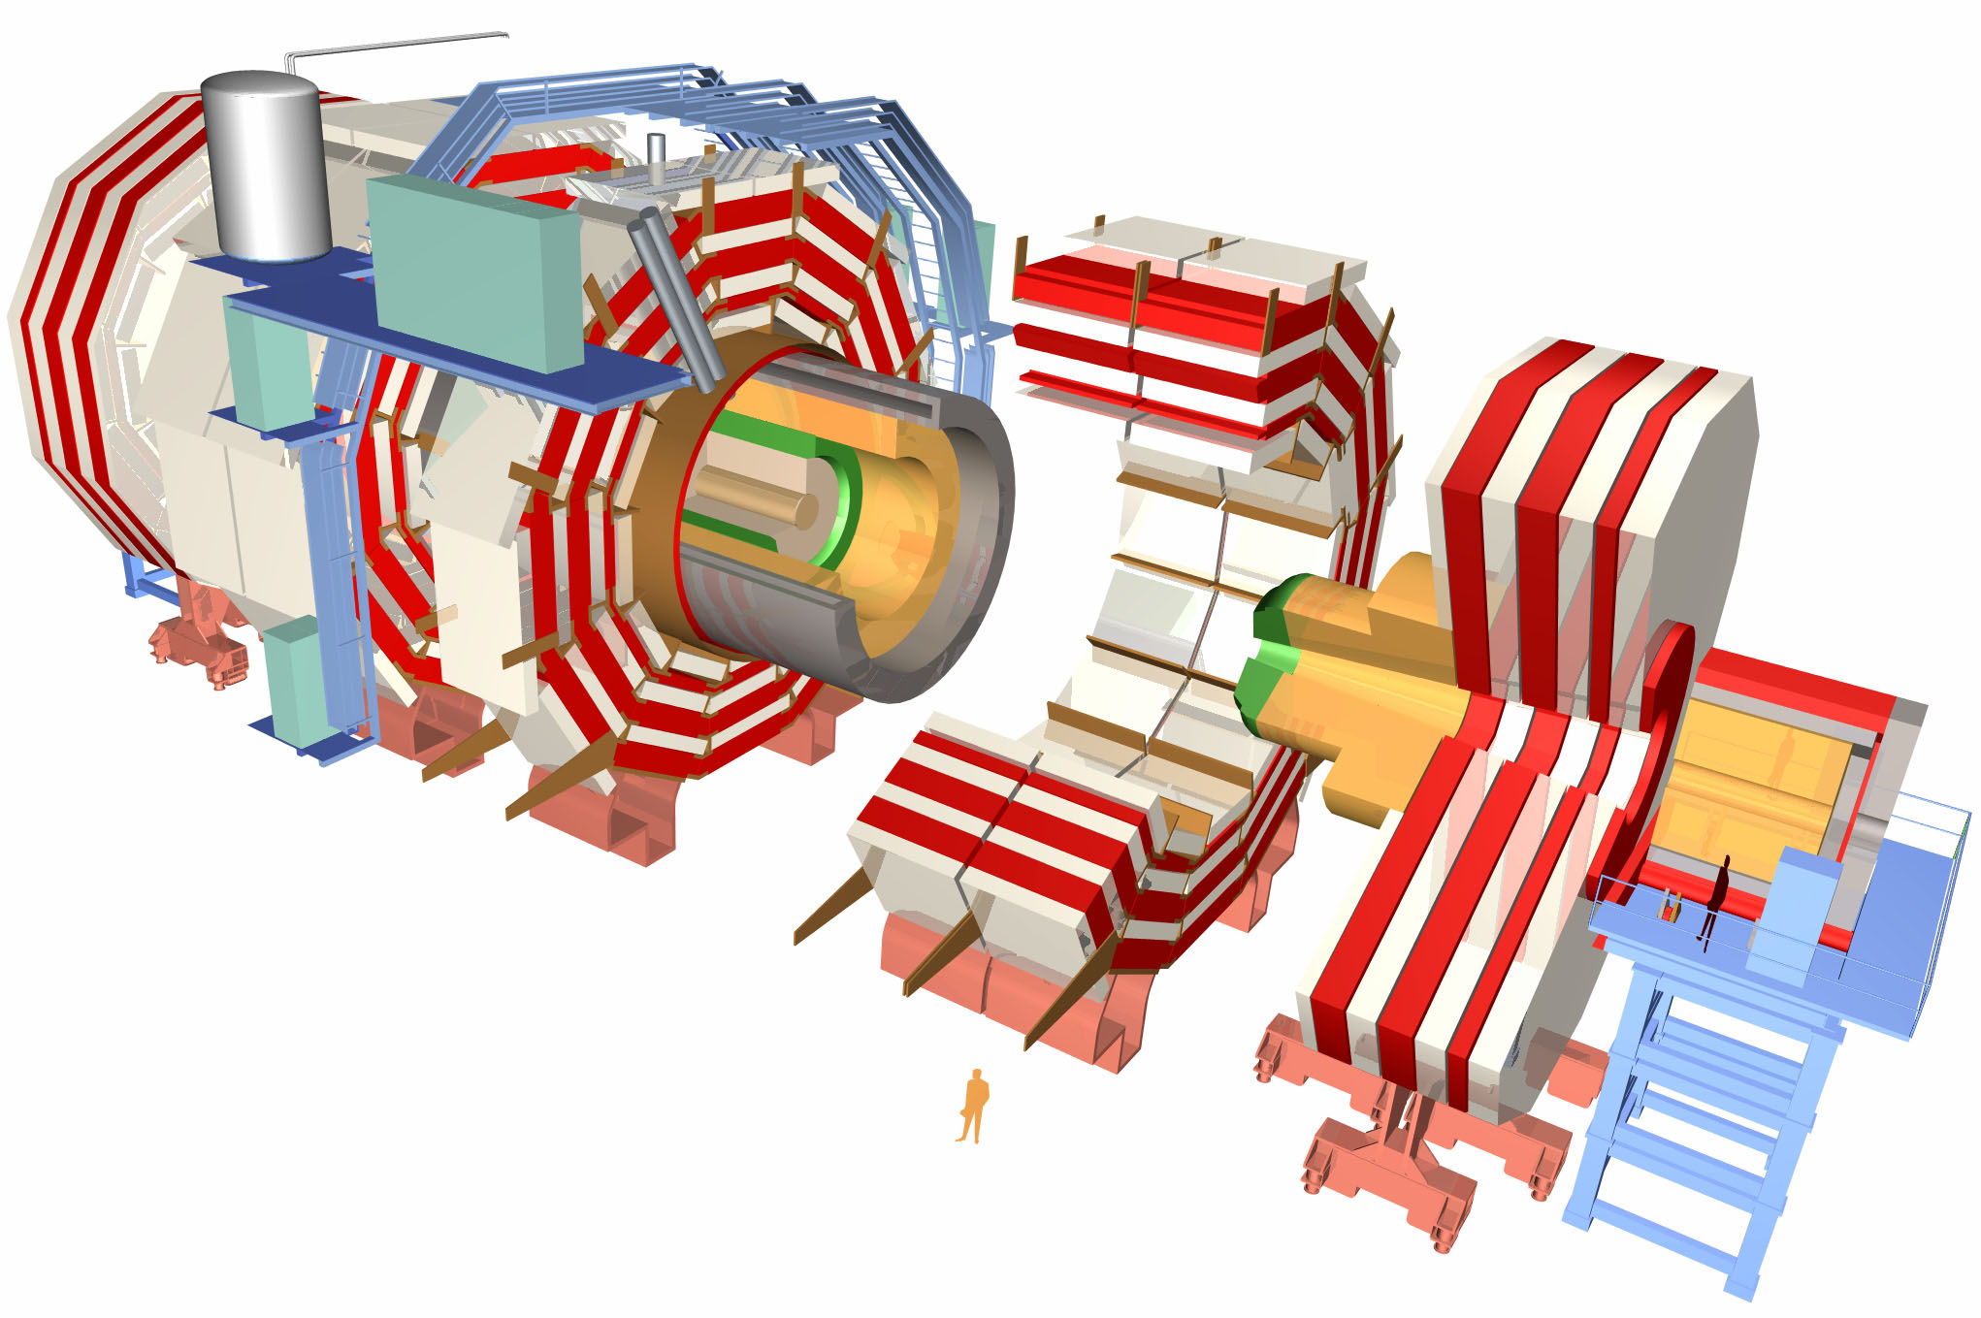
15 millions of detection units, each responding 40 million times per second.
Each second it stores the equivalent to 10 000 British encyclopedias
CMS
12 500 tons,
21.5 meters long,
15 meters diameter

Slide 21
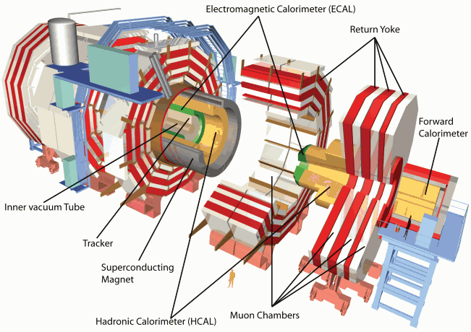
CMS

Slide 22
CMS Coordinate System

Slide 23
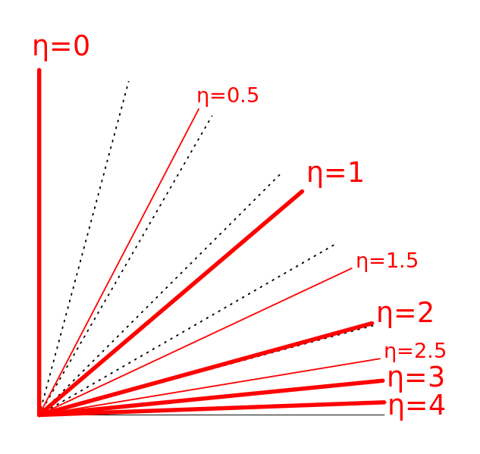
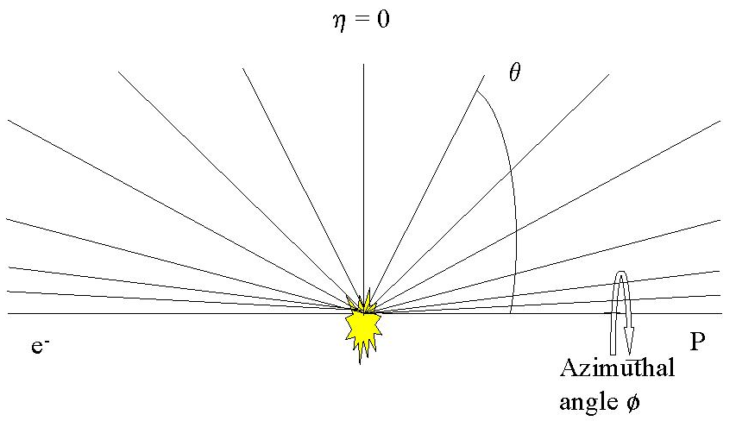
Pseudorapidity

Slide 24
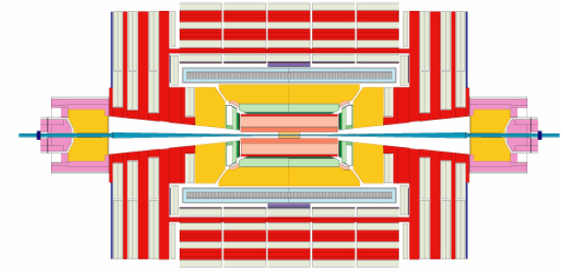
η = 1.1
η = 0
η = -1.1
η = -3.0
η = 3.0
η = 5.31
η = -5.31

Slide 25
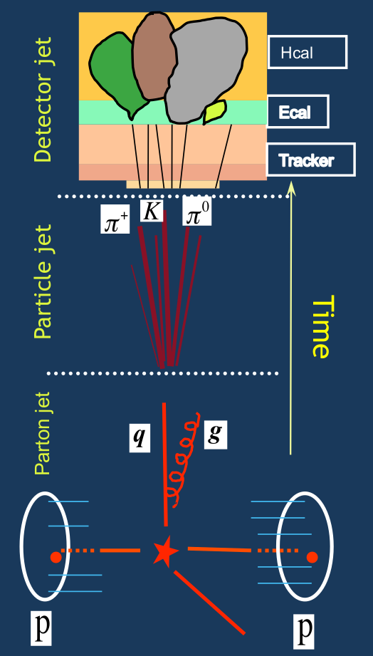
Jets
Jet reconstruction

Slide 26
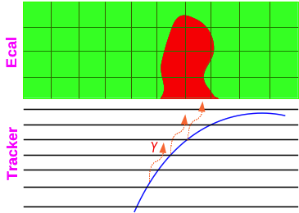
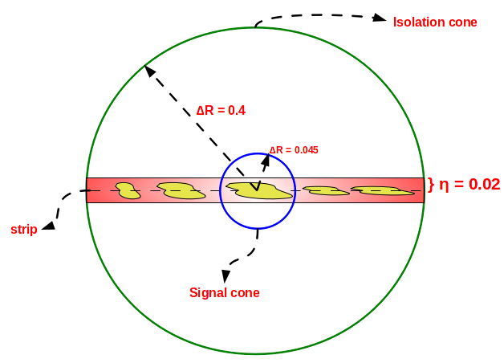
Particle Reconstruction Techiques

Slide 27
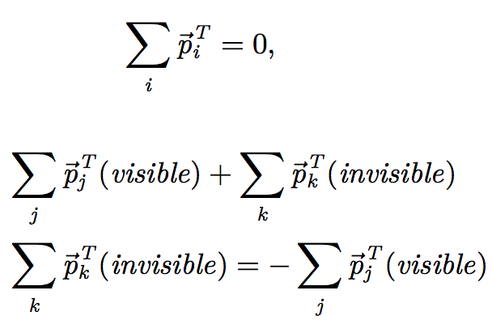
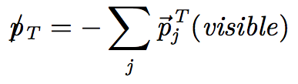
Missing Transverse Momentum (Energy)

Slide 28
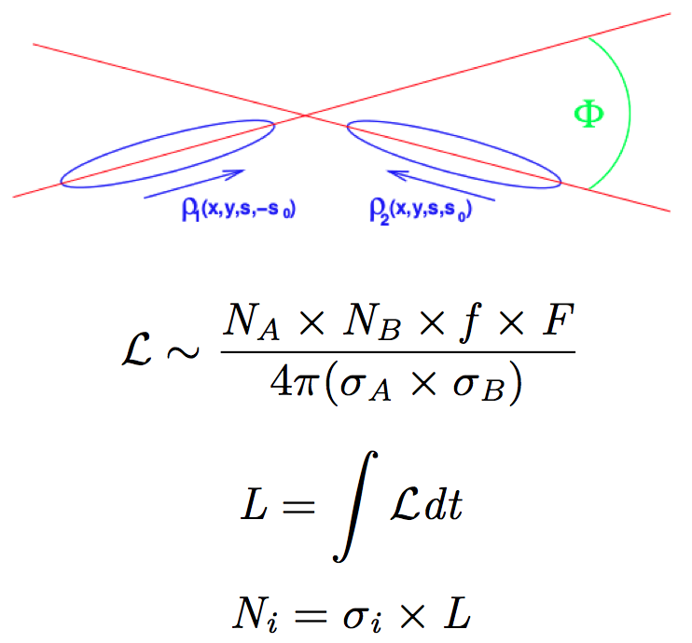
Luminosity

Slide 29
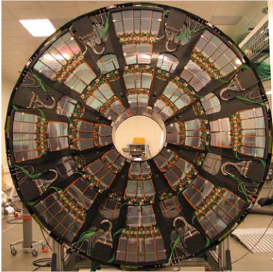
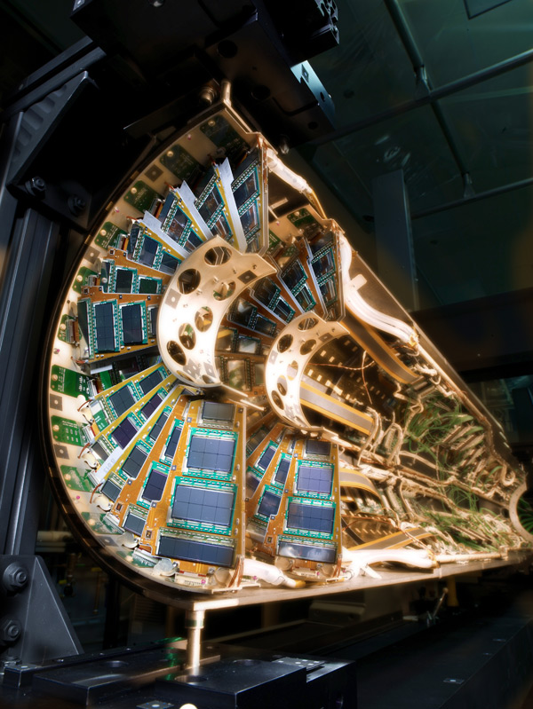
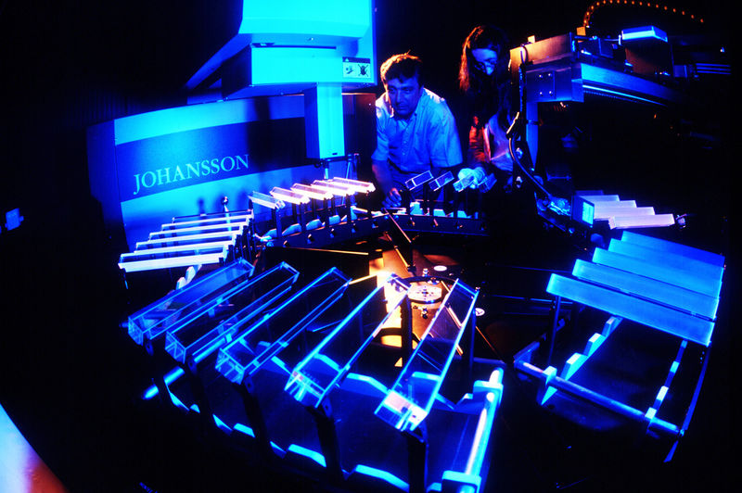
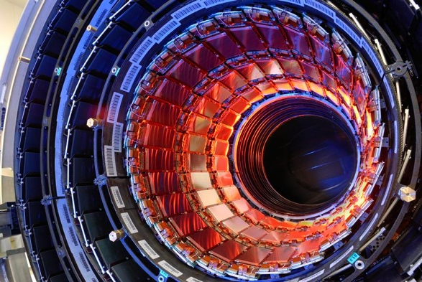
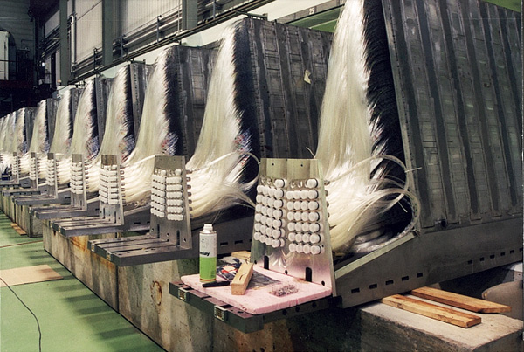
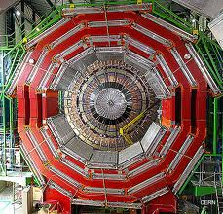

Slide 30
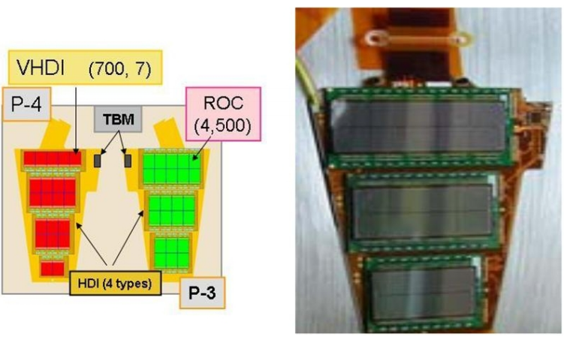
Pixel Detector

Slide 31
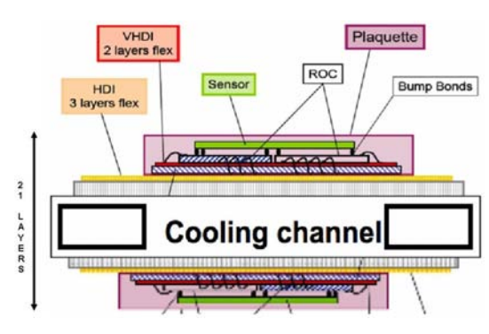
Pixel Detector

Slide 32
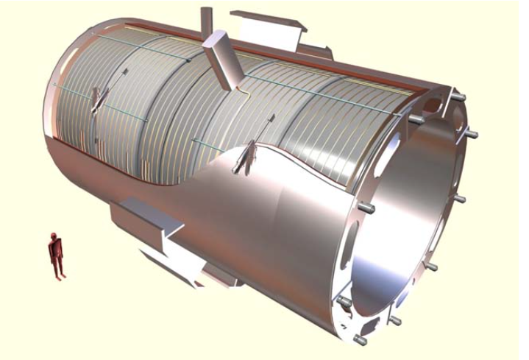
Solenoide Superconductor

Slide 33

Campo magnético del CMS

Slide 34

Characteristics of the Solenoid

Slide 35


Slide 36


Slide 37

Notes:
HIG-13-002 Event 1: Event recorded with the CMS detector in 2012 at a proton-proton centre-of-mass energy of 8 TeV. The event shows characteristics expected from the decay of the SM Higgs boson to a pair of Z bosons, one of which subsequently decays to a pair of electrons (green lines and green towers) and the other Z decays to a pair of muons (red lines). The event could also be due to known Standard Model background processes.

Slide 38


Slide 39

Tracker System
Tubes: 4 mm, wire: 31 μm
52544 tubes
Xenon

Slide 40

Tracker System

Slide 41

Electromagnetic Calorimeter

Slide 42

Hadronic Calorimeter

Slide 43

Muon System

Slide 44

Muon System

Slide 45

ATLAS Toroids

Slide 46
Lets compare…
CMS
ATLAS
Tracker system:
Silicon Pixels
Silicon Strips
Solenoid (3.8 T)
Electromagnetic calorimeter:
Lead tungstate crystals
Hadronic calorimeter:
Brass
Muon system:
DTs RPCs, CST
Tracker system :
Silicon Pixels
Liquid Argon
TRT
Solenoid (2.0 T)
Electromagnetic calorimeter:
Liquid Argon
Hadronic calorimeter:
Steal
Muon system:
MDTs, RPCs, CST, TGC
Toroids

Slide 47

GRID
World-wide network of computers used to analyse data from the LHC experiements at CERN.

Slide 48

Computadores del CERN

Slide 49


Supersymmetry (SUSY)

Slide 50

SUSY
SUSY propose a new symmetry between matter and force fields.
Some SUSY models naturally provide a dark matter candidate.
It predict the unification of the known interaction at large energy scales.

Slide 51

SUSY Searches at the LHC

Slide 52




Particle Physics & Cosmology
How much Bino, Wino, and Higgsino for the DM?

Slide 53

Other Models Besides SUSY…..

Slide 54

THANK YOU
Photoshop

Slide 55

¿Questions?

Slide 56
REFERENCIAS
http://iopscience.iop.org/article/10.1088/1748-0221/3/08/S08003/pdf
http://iopscience.iop.org/article/10.1088/1748-0221/3/08/S08004/pdf

